Slide 1
Abstract Classes
An abstract class usually has one or more abstract methods.
Classes which inherit from it need to provide some effective methods but some methods will already be implemented.
Therefore, all classes that inherit from a particular abstract class have some common code
Classes which inherit from an abstract class use Implementation Inheritance

Slide 2
public abstract class Door //notice the keyword abstract in the class declaration
{
private double height;
private double width;
private boolean locked = false;
public Door(double height, double width)
{ //you cannot create an object from this class directly ie new Door(10.0, 5.0);
this.width = width;
this.height = height;
}
public void lock()
{
locked = true;
}
public void unlock()
{
locked = false;
}
public double area()
{
return height*width;
}
public abstract void open(); //notice the missing implementation
}

Slide 3
Abstract Classes
What is different about abstract classes?
The class declaration has the keyword abstract
You CANNOT create objects using an abstract class e.g
Door d1 = new Door(5, 6); // not possible !!
Do abstract class have to have abstract methods?
NO
An abstract class is created purely for inheritance, to be a super class

Slide 4
Inheritance: Overriding
A child may override a parent method
We know for overriding:
The child class can provide an alternate implementation for a parent’s method
Method signature must be the same
For abstract methods: A child MUST implement (override the empty method body) of an abstract method in the parent class

Slide 5
Accessing Parent Methods
A child may
Call a parent method
Redefine an effective parent method (override)
Effect (provide implementation of) a parent method – if it is abstract
A child method cannot have less visibility than its parent
If the parent is public than the child must be public.
If the parent is protected the child must be public or protected.
A child method should do more than its parent

Slide 6
public abstract class Door //notice the keyword abstract in the class declaration
{
private double height;
private double width;
private boolean locked = false;
public Door(double height, double width)
{ //you cannot create an object from this class directly ie new Door(10.0, 5.0);
this.width = width;
this.height = height;
}
public void lock()
{
locked = true;
}
public void unlock()
{
locked = false;
}
public double area()
{
return height*width;
}
public abstract void open(); //notice the missing implementation
}

Slide 7
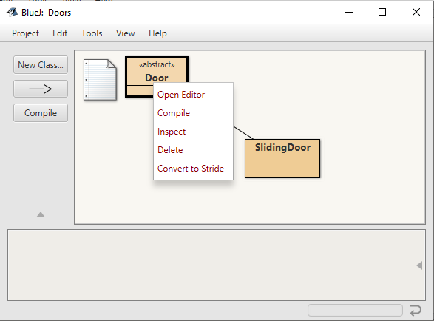
Cannot create a Door object
new Door() is not an option when you right click on an abstract class – you can’t create an object !!

Slide 8
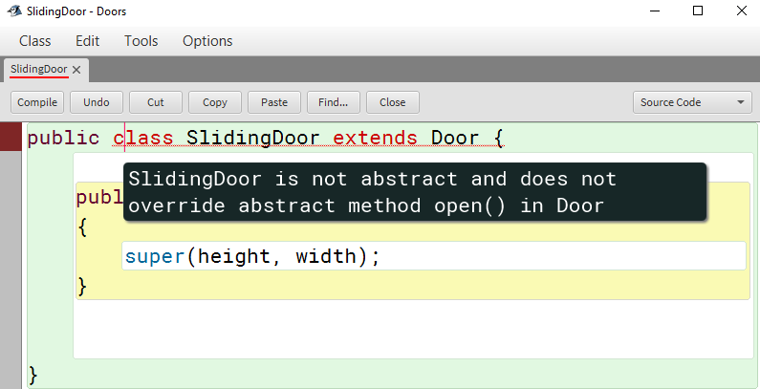
Child Class SlidingDoor
SlidingDoor class inherits from abstract class Door
SlidingDoor must provide an implementation of ALL abstract methods in Door
A child must override an abstract method in the parent class
The method open() must be implemented in SlidingDoor, if not:

Slide 9
public class SlidingDoor extends Door {
public SlidingDoor(double height, double width)
{
super(height, width);
}
public void open() //provide implementation of open()
{
System.out.println(“Slide to open”);
}
}

Slide 10
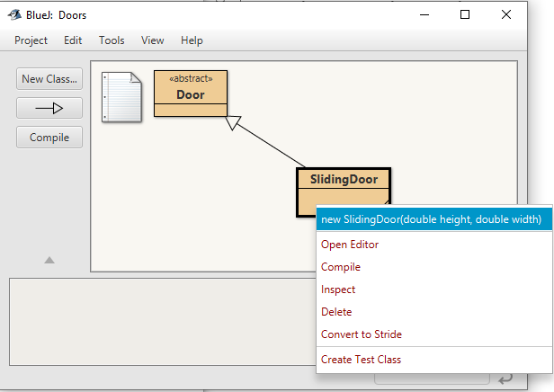
Create a SlidingDoor Object
SlidingDoor is a concrete class.
It extends the abstract class Door
It implements the open() method
We can create SlidingDoor objects

Slide 11
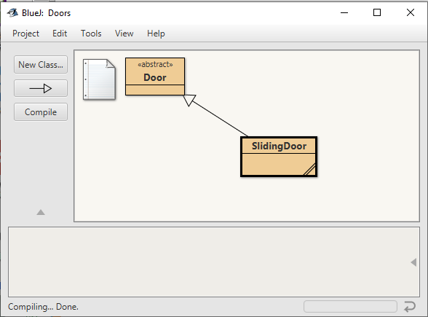
Class Diagram
Abstract classes use this notation in class diagrams:
<<abstract>>
OR
<<Door>>

